Slide 1
Sports League Track-System
Team 6
Yuxuan Sun, Bingying Liang, Yanxin Wang

Slide 2
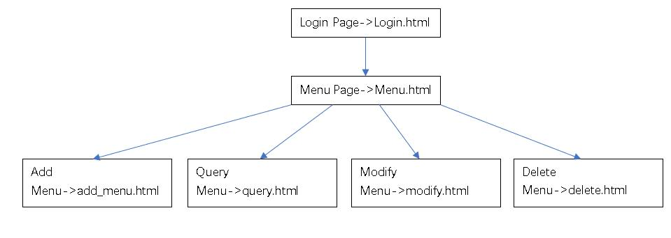
Frontend

Slide 3
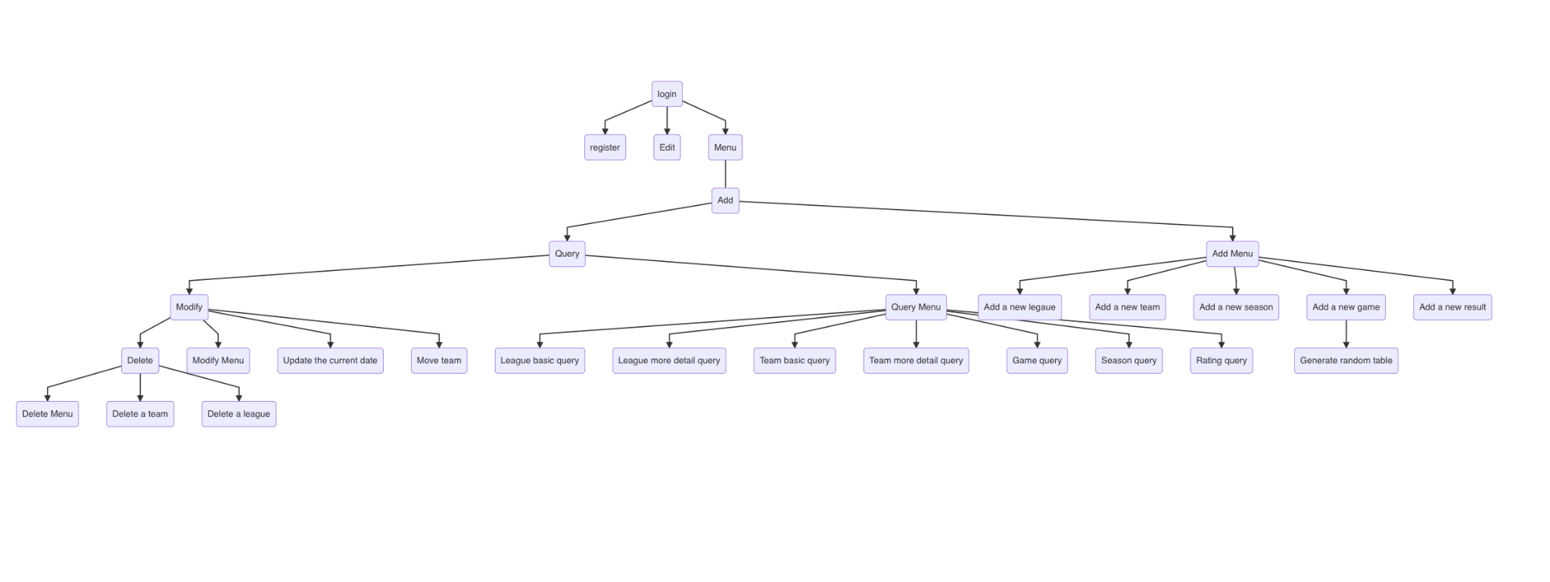

Slide 4
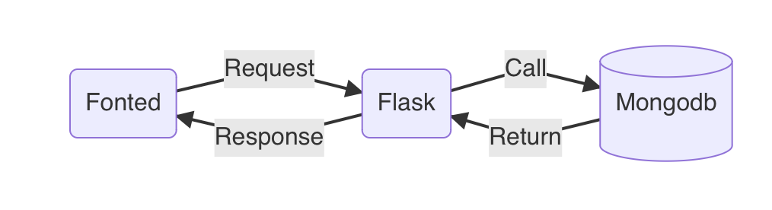
Interaction
flask framework to connect the frontend and backend.
set some limit on fonted data.
e.g input cannot be null.

Slide 5
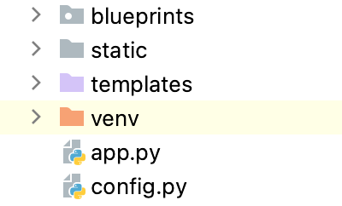
Overall Framework
Divided as three parts
app.py which include the main logic of our applications.
static and templates flies we store the fronted pages in the flask framework.
And the then the blueprints stores the functions of the application which help us to do different operations.

Slide 6
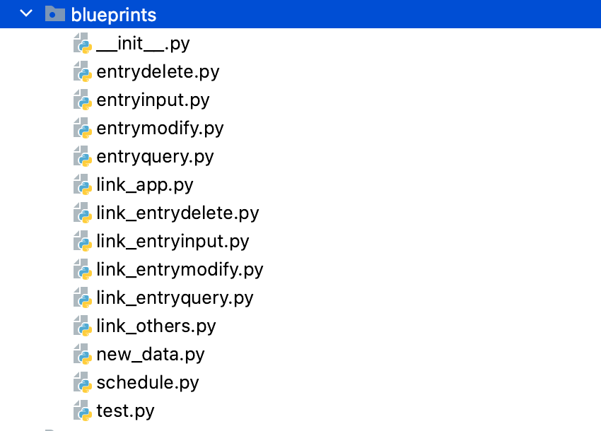
Blueprints
Four python documents in the redbox is to get the data and do data washing.
In the greenbox is to connect the database to do more logic processing.
This our blueprints to schedule the whole application.
More details can see our code files.

Slide 7
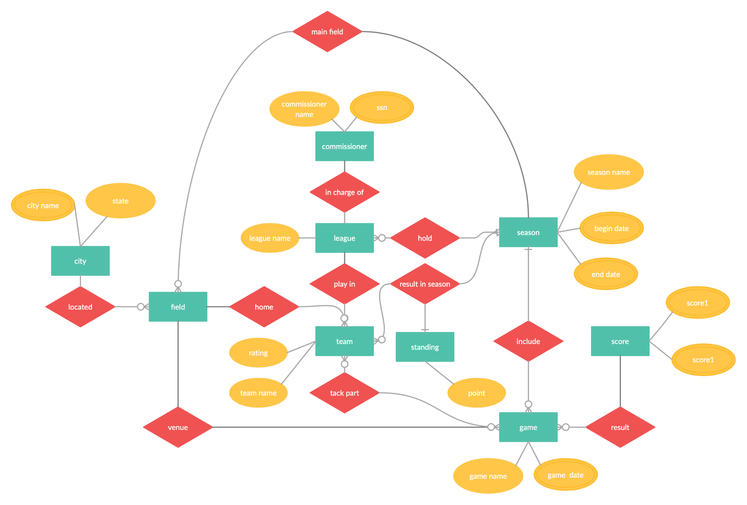
Backend
The structure of the documents in database, which not means this is a relation database.
The reason why split the structure in such amount of documents is used for the development of the systems.

Slide 8
When the system is perfect enough in the future, the id of the document can be directly called to obtain the attribute data, which will save time when the amount of data is large. Unfortunately, we still have to search from top documents to target document doing the process.

Slide 9
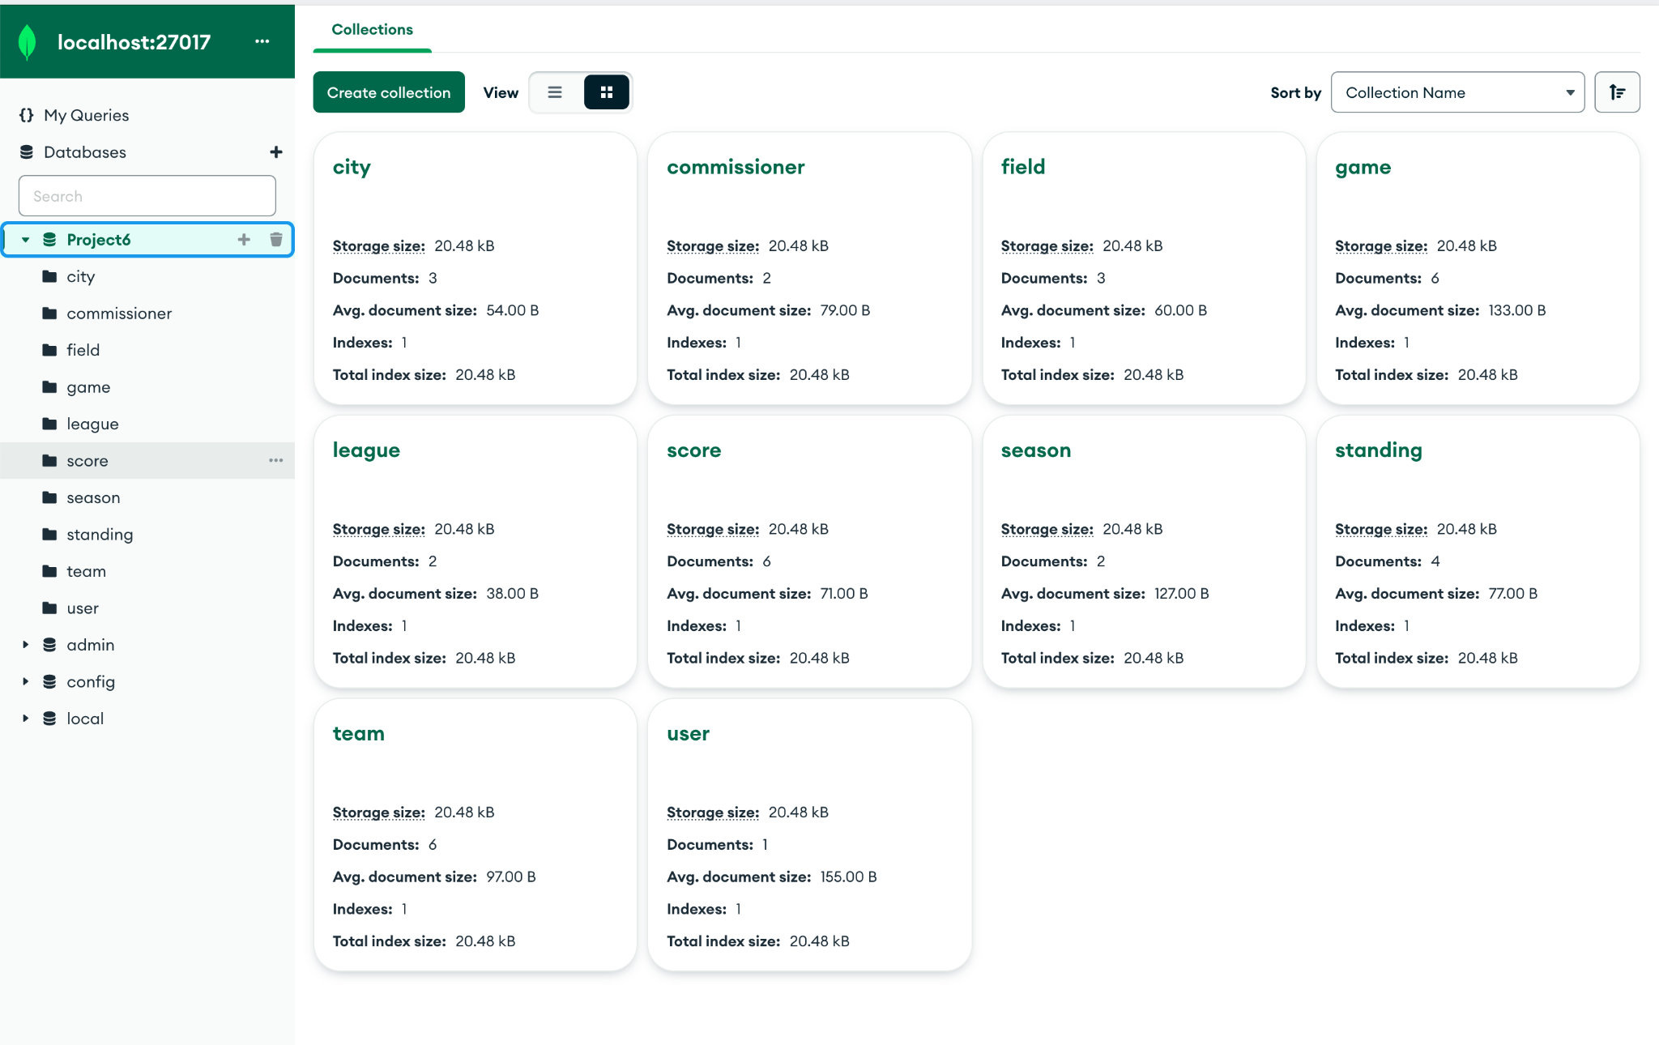

Slide 10
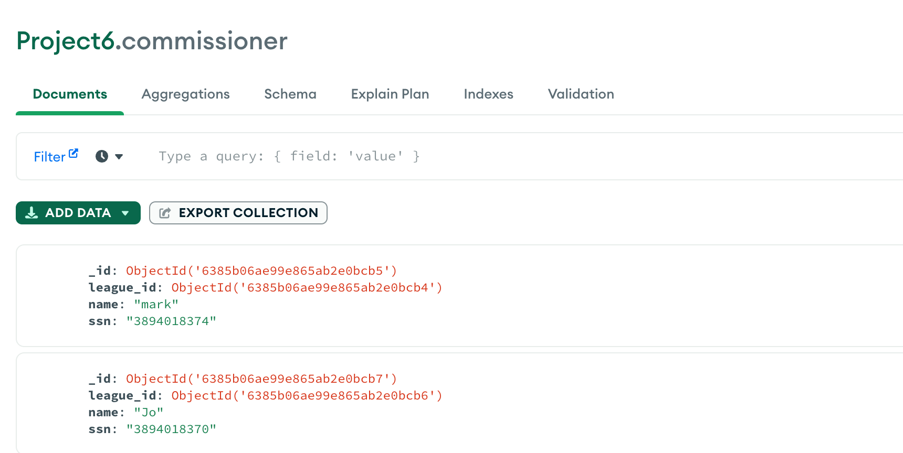

Slide 11
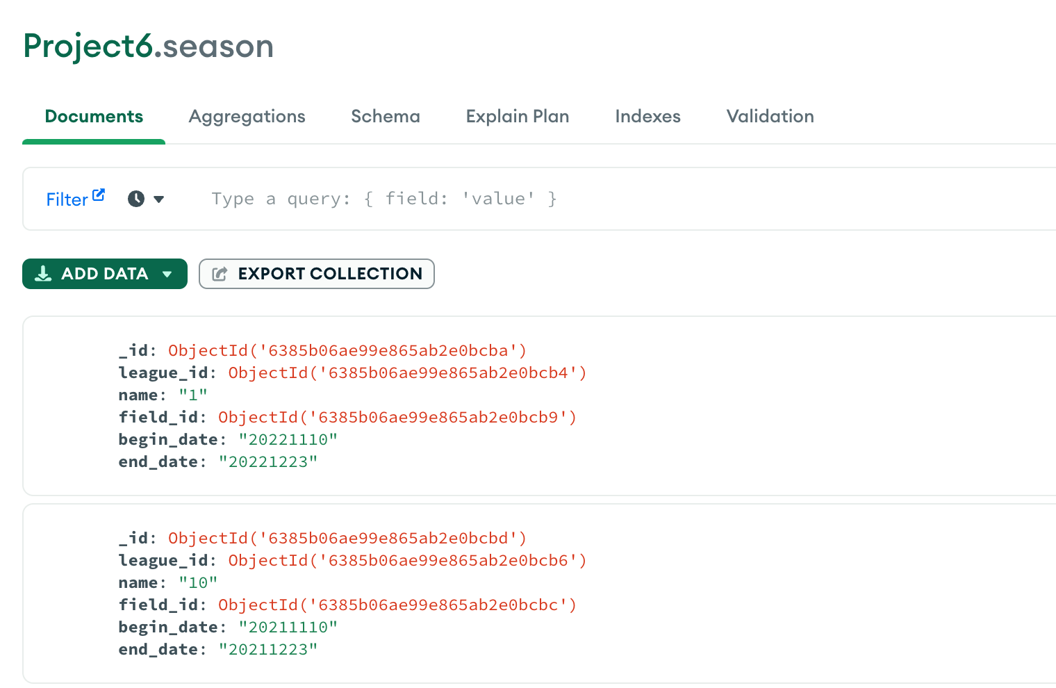

Slide 12
Four highlights in the back-end program
.py file name | function name | Explanation
link_app.py | link_login, link_register, link_edit | Using hash encryption to protect passwords security
schedule | groupStage | Called in function link_generate_random_table in file link_entryinput. By using combinations to get a matchup table for all teams in the current league and disrupt the order.
link_other.py | link_score_input | Called in function link_result_input in file link_entryinput. Change the current season team points by calculating the game score of both teams. The winning team accumulates three points, the losing team has no points, and the tie-breakers each accumulate one point.
link_other.py | calculate_rating | Called in function link_rating_query in file link_entryquery.Write a matrix of all the teams in the current league matchups. Then find the eigenvalues of the matrix as the rating of each team.

Slide 13
First
.py file name | function name | Explanation
link_app.py | link_login, link_register, link_edit | Using hash encryption to protect passwords security

Slide 14
Second
.py file name | function name | Explanation
schedule | groupStage | Called in function link_generate_random_table in file link_entryinput. By using combinations to get a matchup table for all teams in the current league and disrupt the order.

Slide 15
Third
.py file name | function name | Explanation
link_other.py | link_score_input | Called in function link_result_input in file link_entryinput. Change the current season team points by calculating the game score of both teams. The winning team accumulates three points, the losing team has no points, and the tie-breakers each accumulate one point.

Slide 16
Fourth
.py file name | function name | Explanation
link_other.py | calculate_rating | Called in function link_rating_query in file link_entryquery.Write a matrix of all the teams in the current league matchups. Then find the eigenvalues of the matrix as the rating of each team.

Slide 17
Login

Slide 18
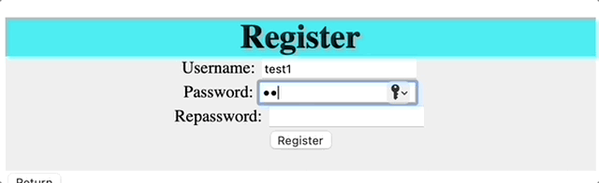
Login & Register
Successful login -> main system menu.
Safety system and want users to join us.
Notes:
From the menu bar select Delete . This will bring up the Delete Menu . Then click which you want to delete. We just give user for two things to delete. If you want to more function about that, please follow the future versions.

Slide 19
Add

Slide 20
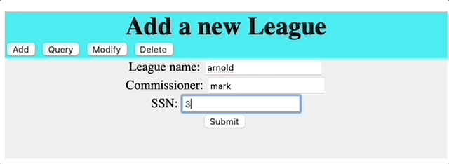
Add a new league
menu bar -> Add -> Add Menu.
Users cannot input null or data already in the database.
We have some limit on that.

Slide 21
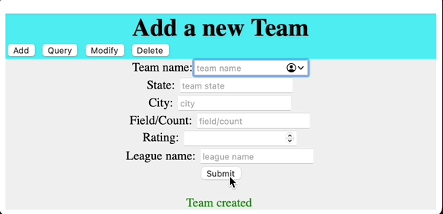
Add a new team
If user do not input the rating we will set it 0.

Slide 22
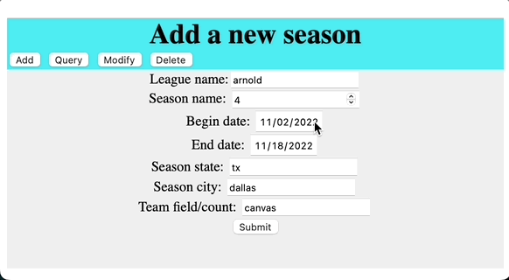
Add a new season
we will do some data cleaning and also check from the database.

Slide 23
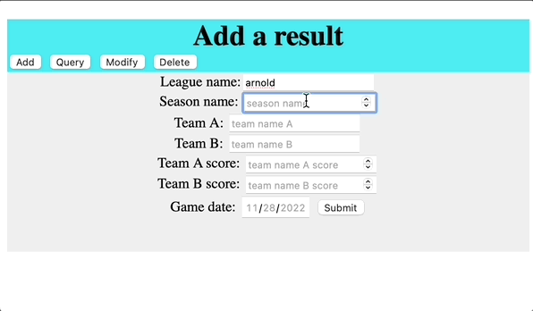
Add a new result
If the input is not allowed, the system will return some hints to tell the users why they can not do that.

Slide 24
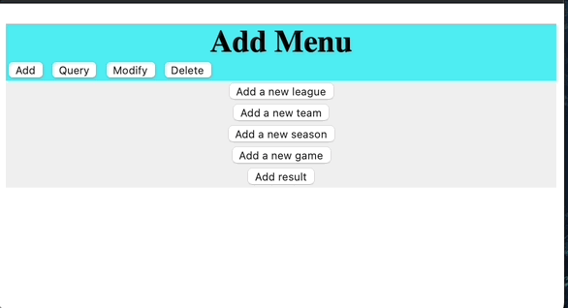
Add a new game
We offer two ways.
manual adding
system generate random games, then you can pick up one to generate the game.

Slide 25
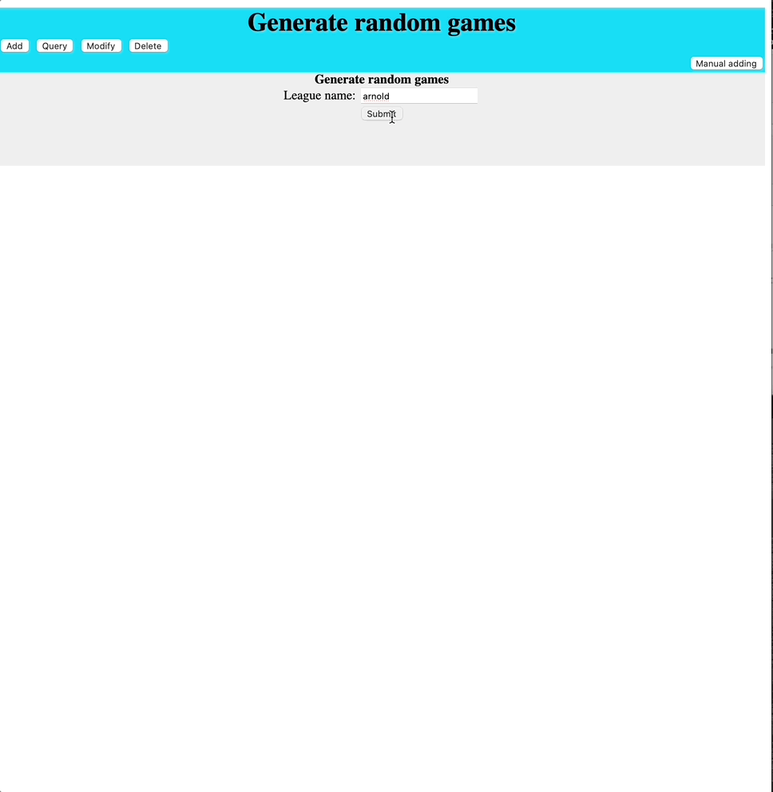
Add a new game
2. system generate random games, then you can pick up one to generate the game.

Slide 26
Query

Slide 27
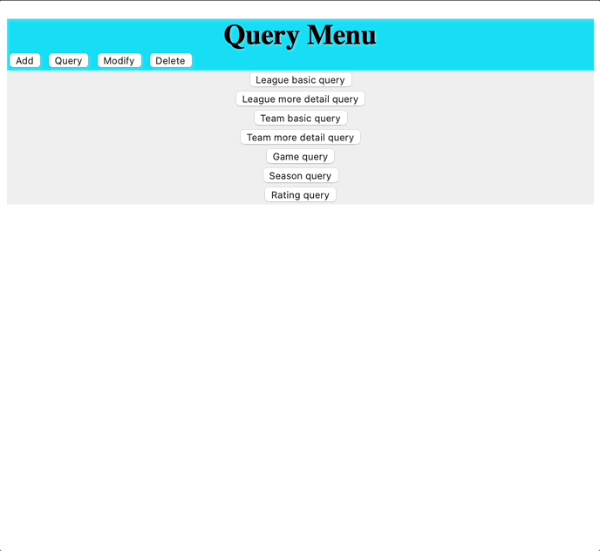
League basic query
Two kinds of league queries, one is basic query, which will return some basic information like league name, commissioner, ssn, seasons.

Slide 28
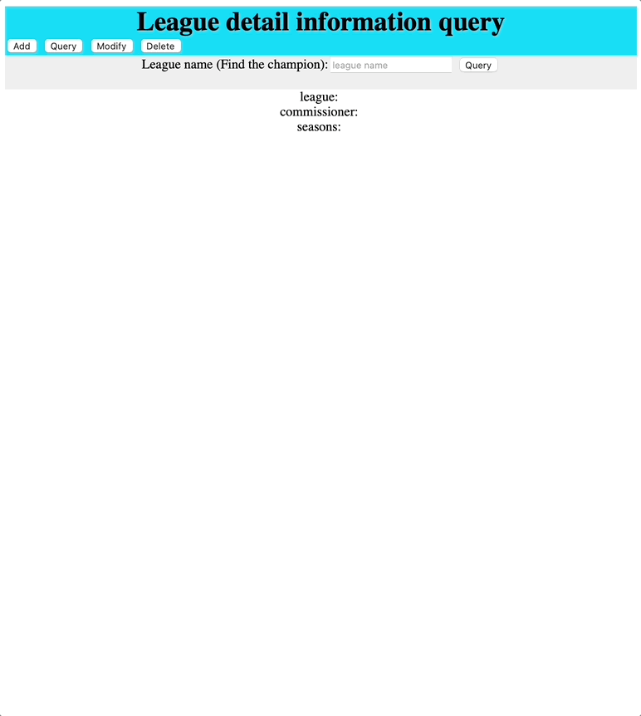
League detail query
This query will offer user more detail information, like champions, game records and so on.

Slide 29
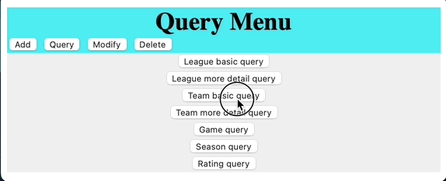
Team basic query
Two kinds of teams queries, one is basic query, which will return some basic information like team name, team state, teamcity, team field and rating.

Slide 30
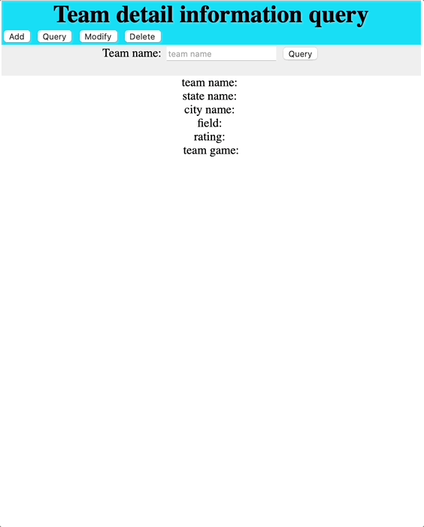
Team basic query
Team detail query will offer user more detail information, like detail about team game records.

Slide 31
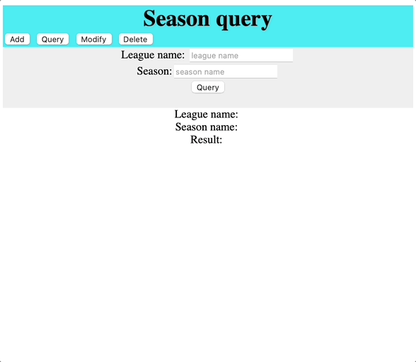
Season query
For the season query, it will show teams details of the seasons.

Slide 32
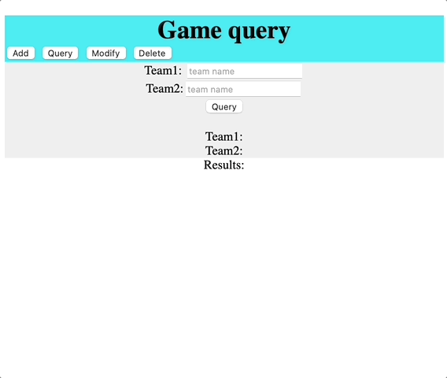
Game query
Game query will show the records about two teams.

Slide 33
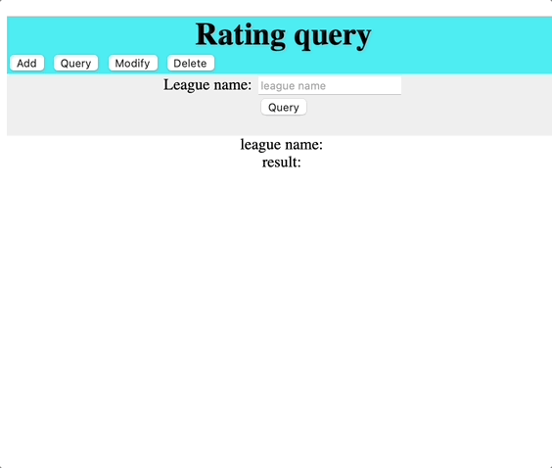
Rating query
Rating query will show the rating order of the teams in league.
It's important to note that if you enable the function to calculate the rating from the feature values, it will overwrite the previous data entered by the user.

Slide 34
Modify

Slide 35
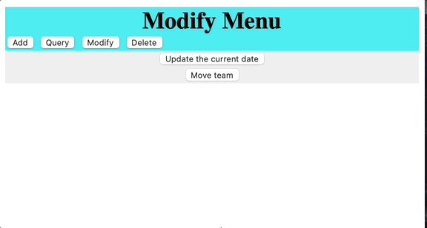
Entry Modify
It could suppose move a old team to the new team.
If the team has games in the future or in the league it will now allow to leave.

Slide 36
Delete

Slide 37
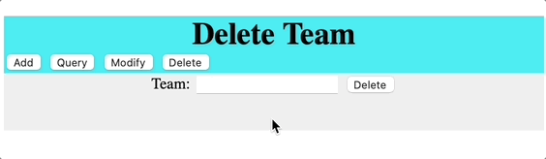
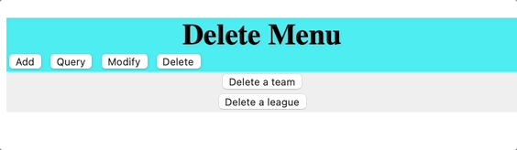
Delete
We just give user for two things to delete.
If you want to more function about that, please follow the future versions. We provide more details in the developer manual.
If necessary, we hope more developers can add more different functions.

Slide 38
Thank you for listening!
The End!

